Slide 1
Solving the problems of a mega-city and addressing universal access and the financing of water utilities
Jerson Kelman, CEO
March 2016

Slide 2
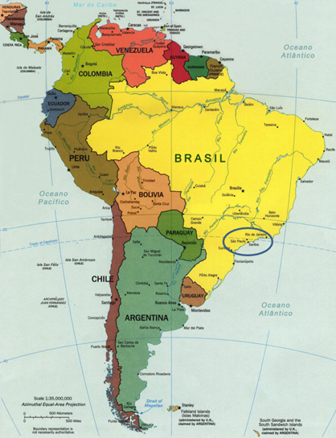
BRAZIL
200 million inhabitants
8.5 million km2
27 states
5,600 municipalities

Slide 3


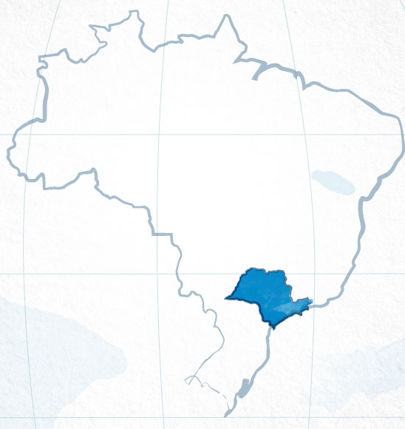
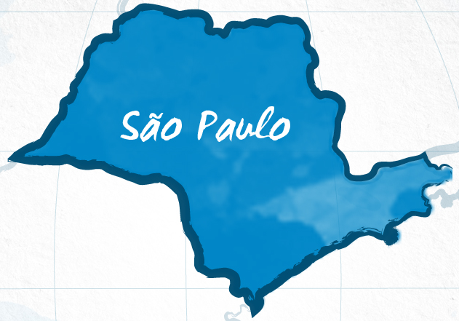
% GDP Brazil = 33%
28 million people
  (3 million in slums)
373 municipalities
Sabesp

Slide 4

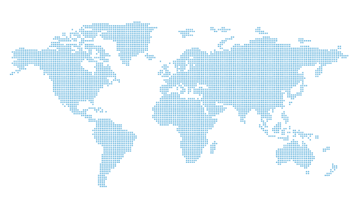

Veolia Environnement
5th LARGEST
COMPANY
Suez Environnement
in the world in number
of clients
Beijing Enterprises Water Gp
FCC (Aqualia)
Shanghai
Industrial
(Source: Pinsent Masons Water Yearbook/2012-2013)
RWE

Slide 5
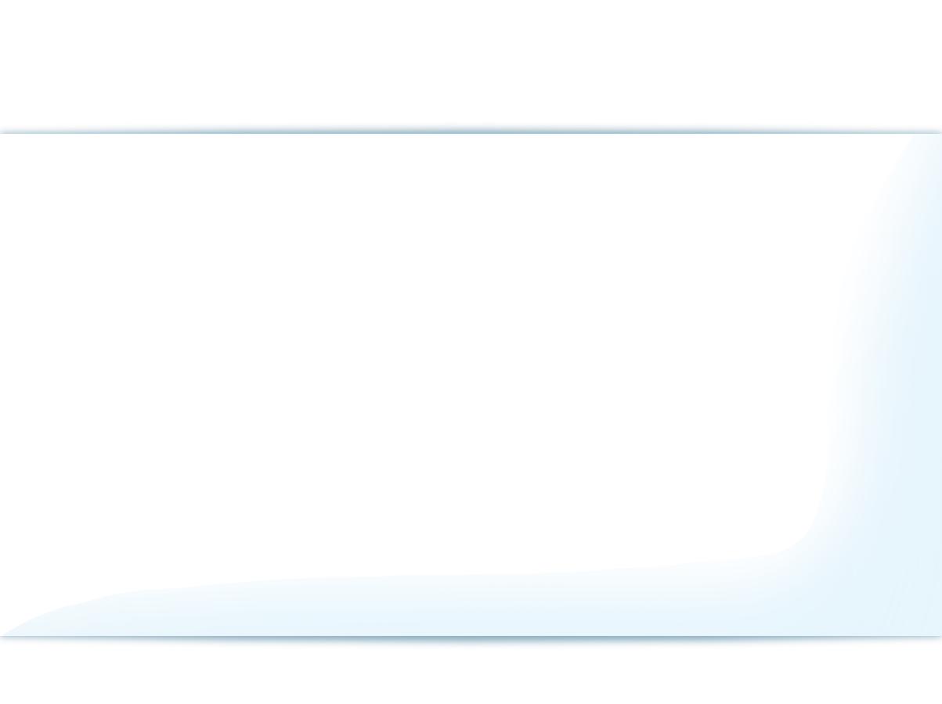
Water & Sewage
70,800 km
Water
pipes
8,2 million
Water
connections
235
Water treatment plants
6,7 million
Sewage
connections
524
Sewage treatment plants
48,000 km
Sewage
pipes
Water delivered to 25 million people
Sewage collected from 22 million people
83% of
collected sewage is treated

Slide 6
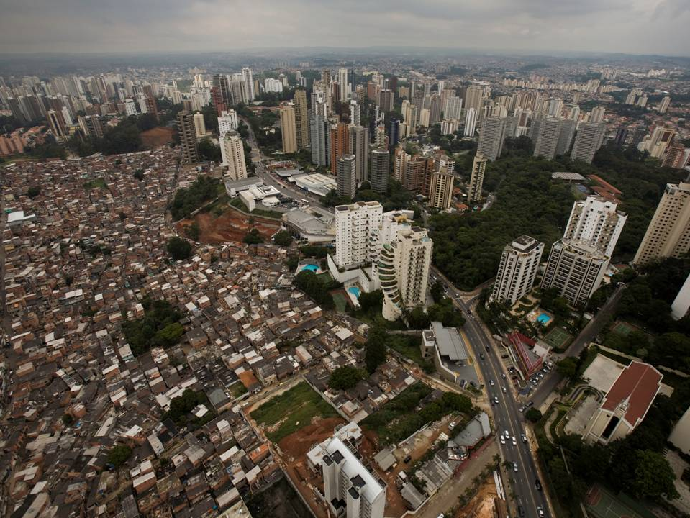

Slide 7
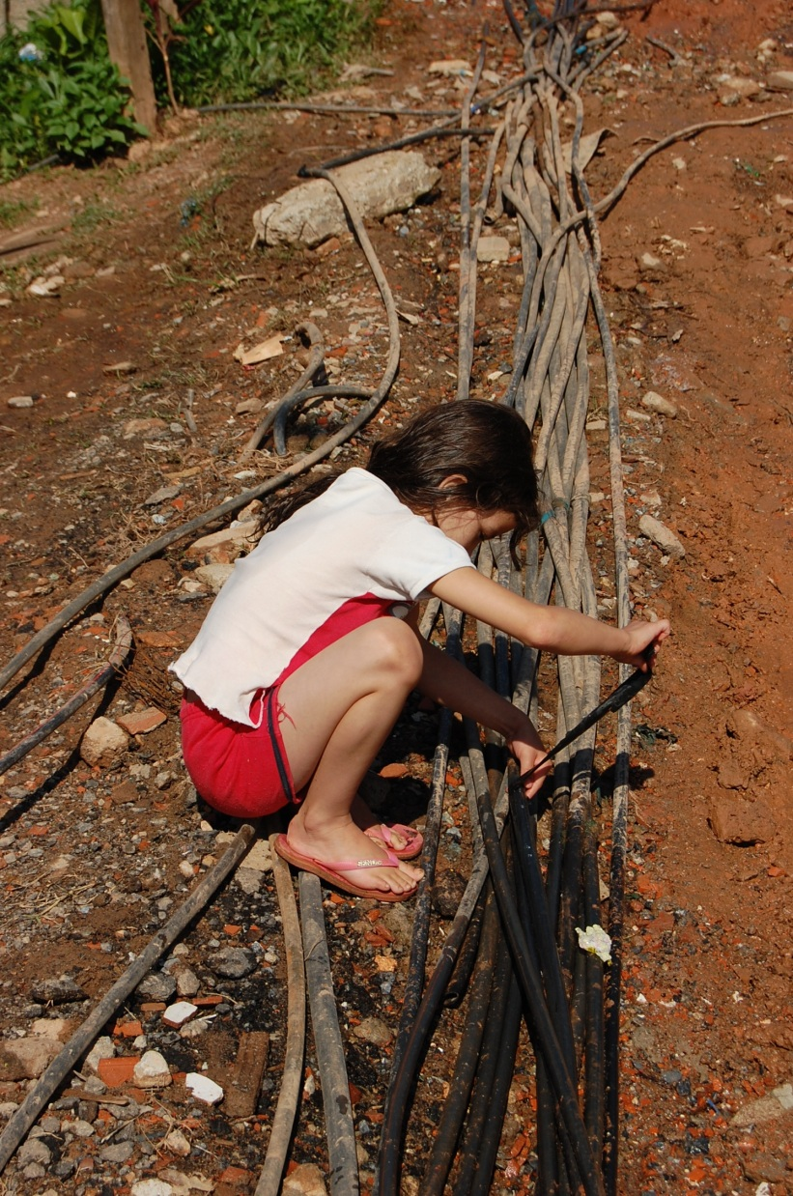
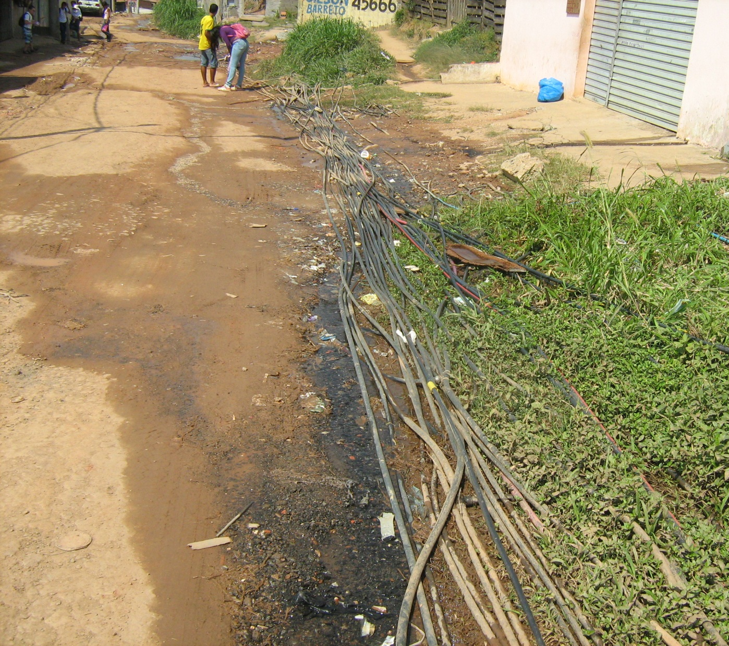

Slide 8
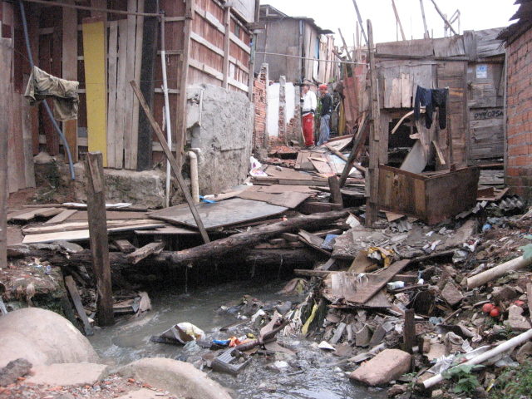

Slide 9

Strong Corporate Governance
    NYSE – Level III ADR
INVESTMENTS
US$ 600 MILLION/YEAR
HALF FINANCED + PPPs
GOVERNAMENTAL SUBSIDIES?
NO
CROSS SUBSIDIES AMONG CONSUMERS?
YES

Slide 10
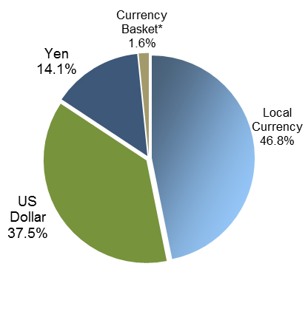
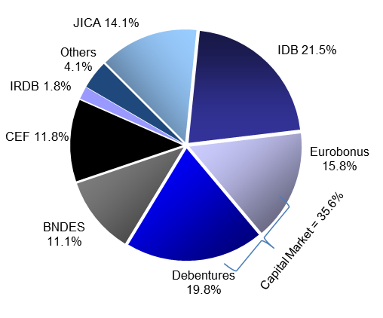
Long Term Low Cost Funding
Total Debt Breakdown
Total debt by currency
Access to national and international
Investment funding
Capital Markets

Slide 11
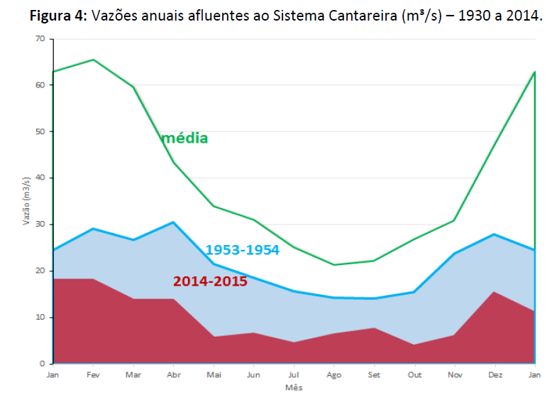
How serious was the 2014 – 2015 drought ?
Average
Historical record: 84 years P(Q<q2014 = 0.004) Recurrence interval: 250 years

Slide 12
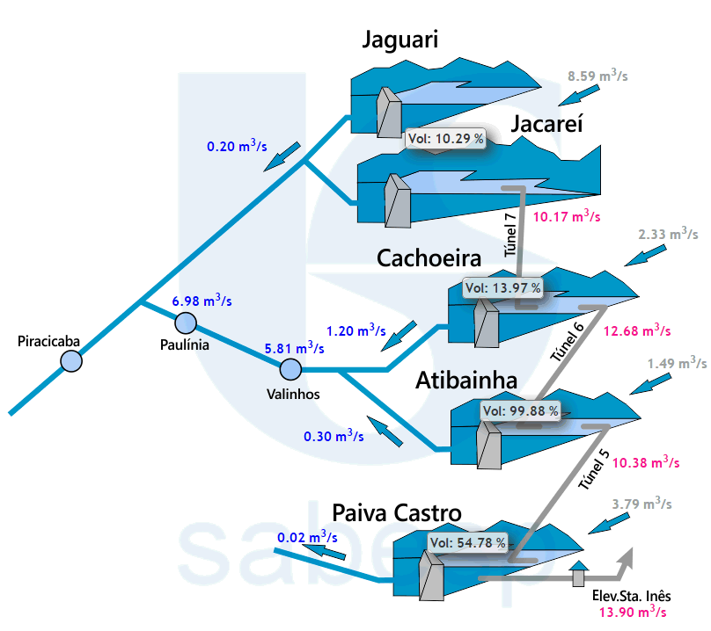

Slide 13
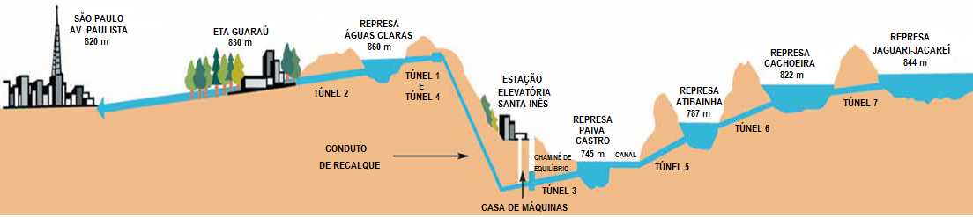
The Cantareira System serves, in normal conditions, almost half of the Sao Paulo metropolitan population (20 million)

Slide 14
Cantareira storage

Slide 15
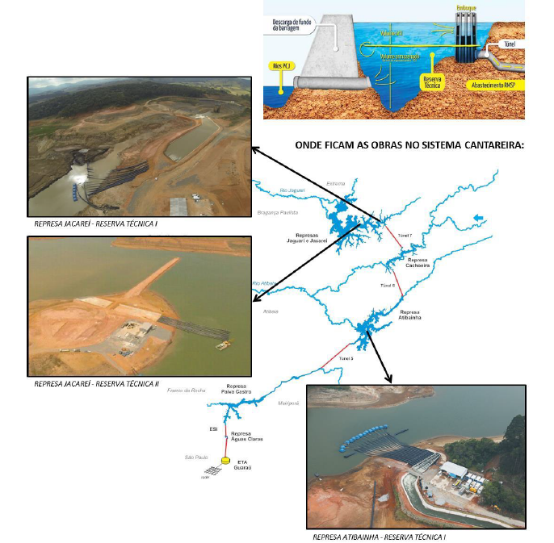
Pump water out of the Cantareira System from a water elevation bellow the intake of the diversion

Slide 16
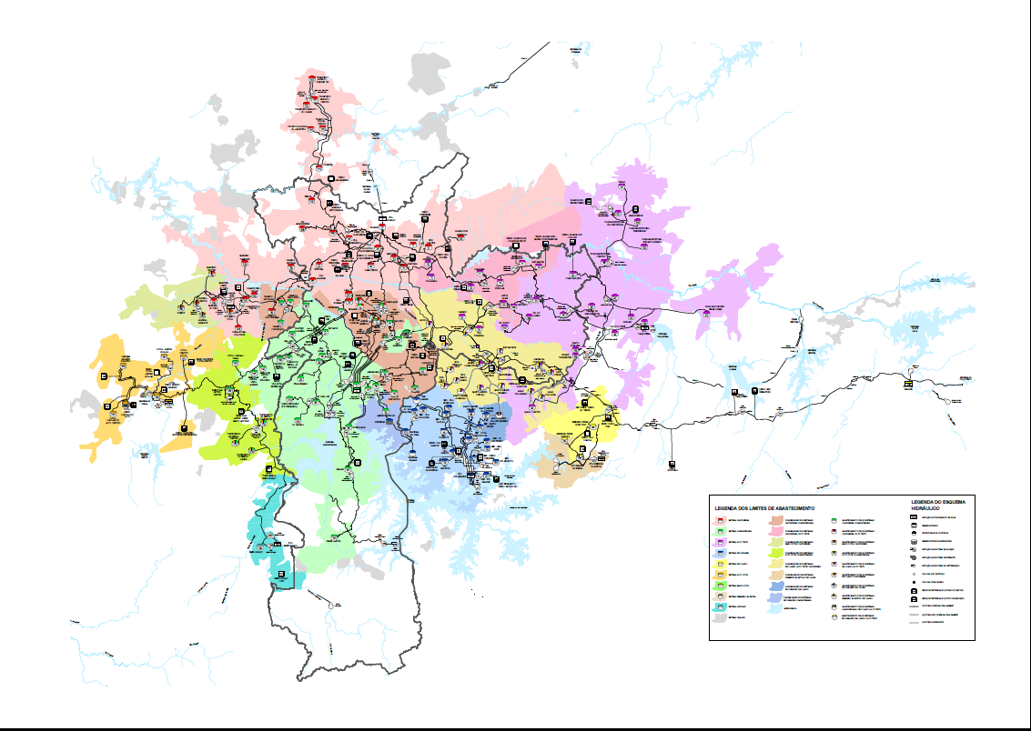

Slide 17
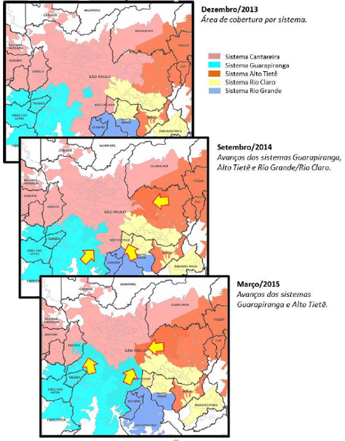

Slide 18
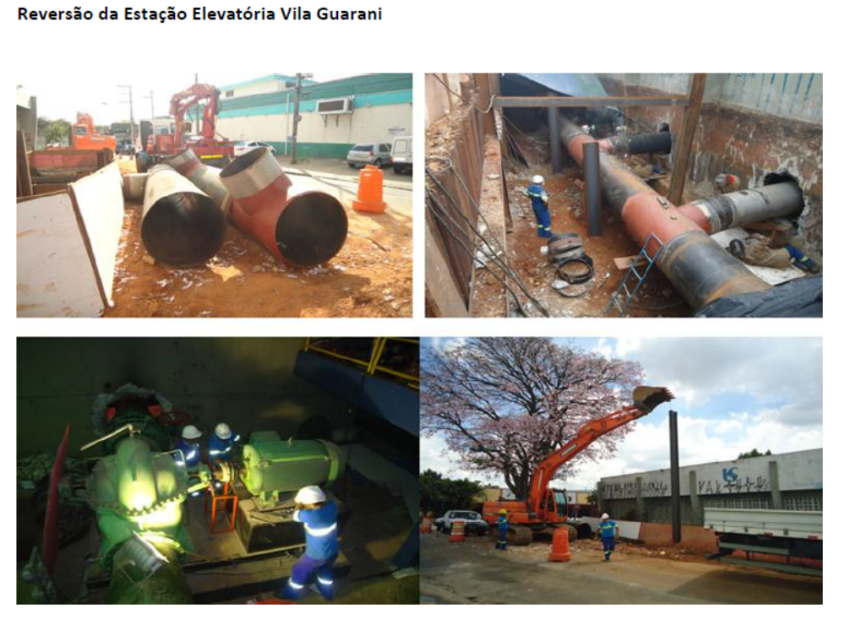
Reversal of Vila Guarani Pumping Station

Slide 19
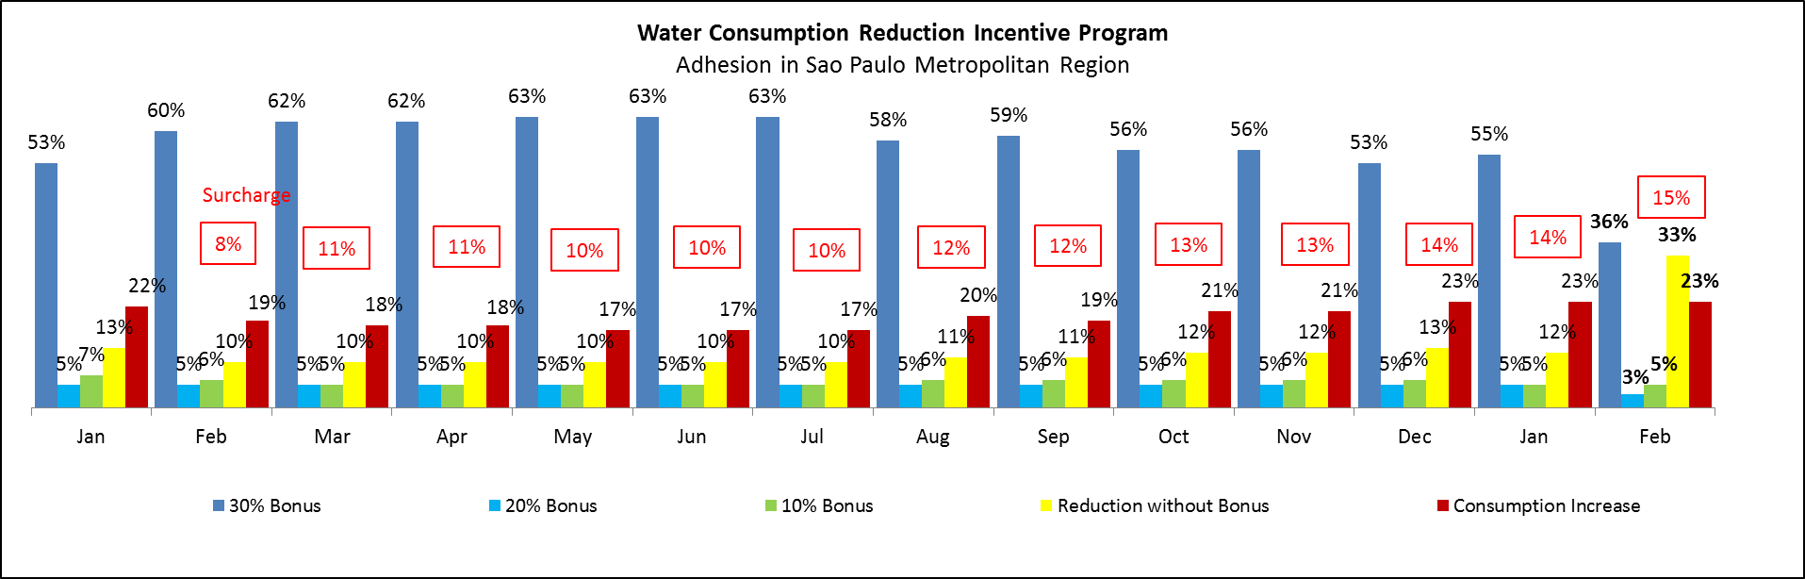
Discounts in the water bill for consumers that save water & penalties for those that overuse
15% of surcharge
and
8% applies to Social Tariff/Consumption below 10m³ (no surcharge)

Slide 20
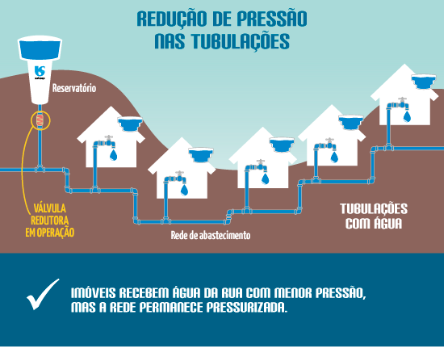
Pressure Reduction
on Distribution Network
RESERVOIRS
PRESSURE REAGULATING VALVES
PIPES WITH WATER
WATER DISTRIBUTION NETWORK
Properties receive water with lower pressure, but the network continued pressurized

Slide 21
Water Production in Cantareira System (m³/s)
Reduction from Initiatives:
(m³/s)
Bonus Program
Water transferred between systems
Pressure Reduction/Losses
Reduction of transferred water to Guarulhos
and São Caetano do Sul
In comparison with February/14, as the last month with regular production, with iniciatives to offset the lower water withdrawal from the Cantareira System

Slide 22
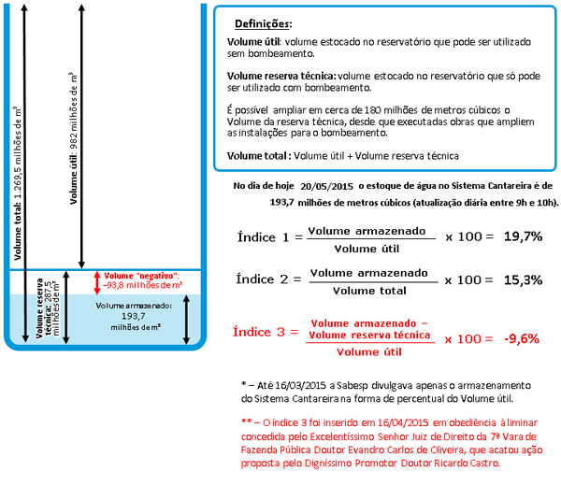

Slide 23


Thank you

